Slide 1
Harness Bookmark

Slide 2

What does this Harness intend to do ?
It deals with Google Crome (browser) based Bookmarks management
Lists Bookmarks alongside folders it belongs to
Lists Bookmark Folder structure
Update new bookmarks in any given folder (User Interactive)
Does Web based search, answer queries and load the URL content (using MCP tool)
Runs only via Terminal window chat

Slide 3
Tools it uses (Native)
Lists Chrome Bookmarks, all or folder-based
Lists Chrome Bookmark Folders
Create New Chrome Bookmarks
NOTE: Chrome profile selection is pre-requisite, and based upon the name of profile .env file must be defined, otherwise "Default" profile is used in the code.

Slide 4
Tools it uses (Non-Native, MCP)
Uses MCPToolset from pydantic_ai.mcp to use tool "mcp_server_fetch"
This MCP tool serves purpose for web search and page fetching

Slide 5
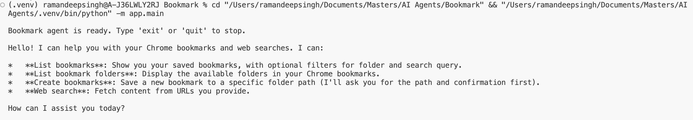
How it works: Initial Loading..(run app.main)

Slide 6
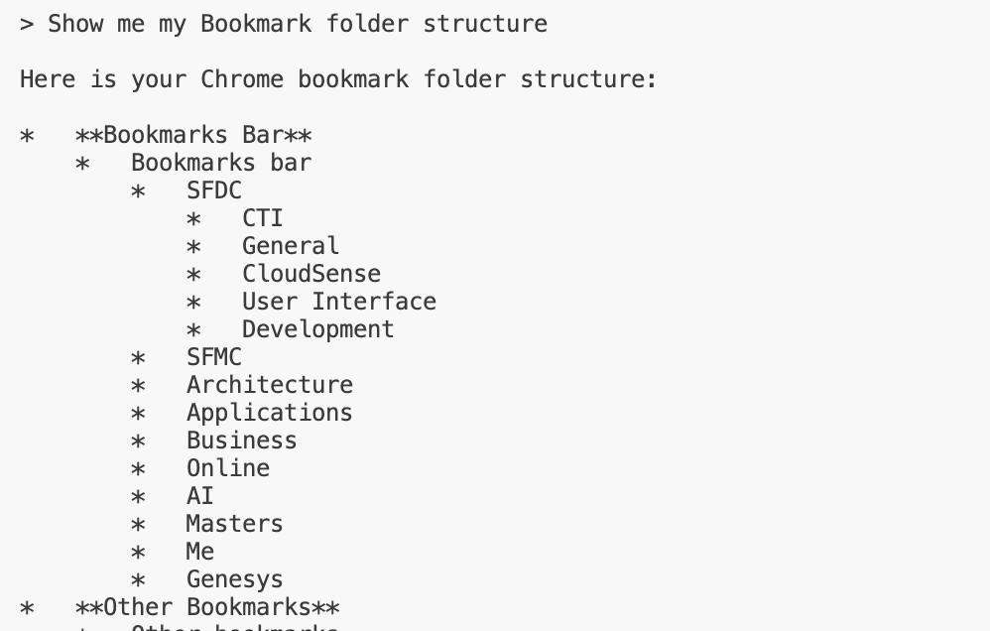
How it works: My folder Structure (Native tool)

Slide 7
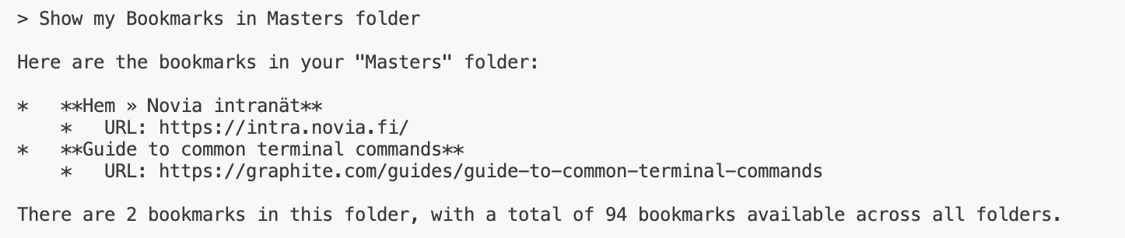
How it works: My Bookmarks in "Masters" folder (Native tool)

Slide 8
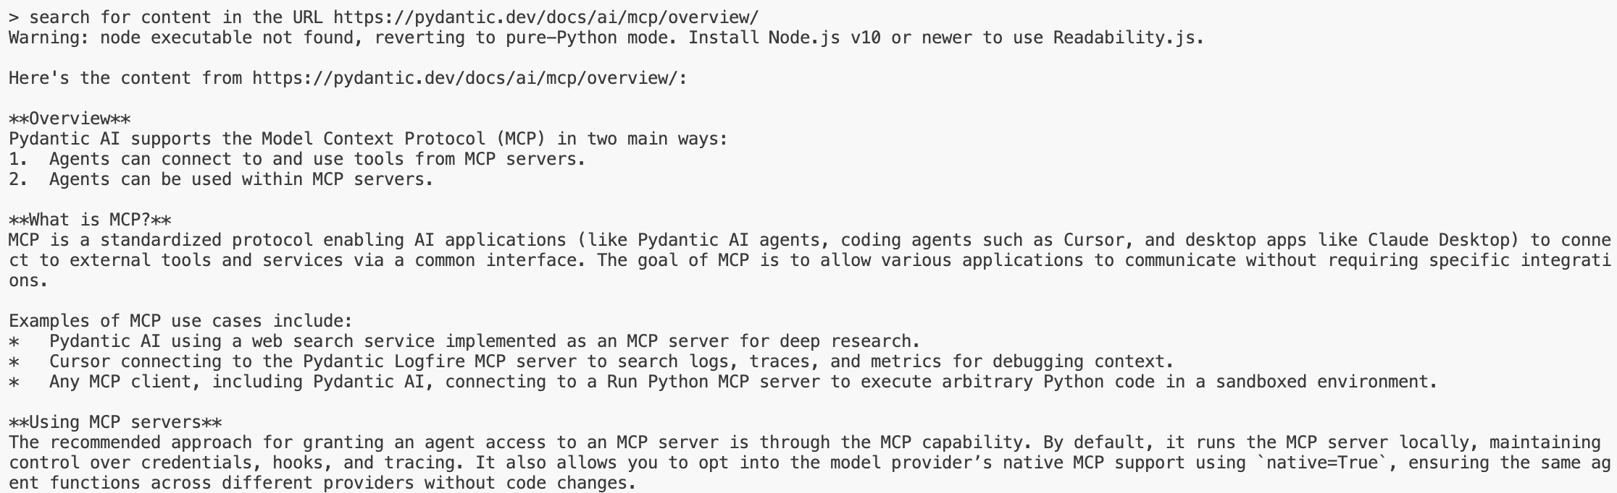
How it works: now I go web URL content search (I prefer to search pydantic) (MCP tool)

Slide 9
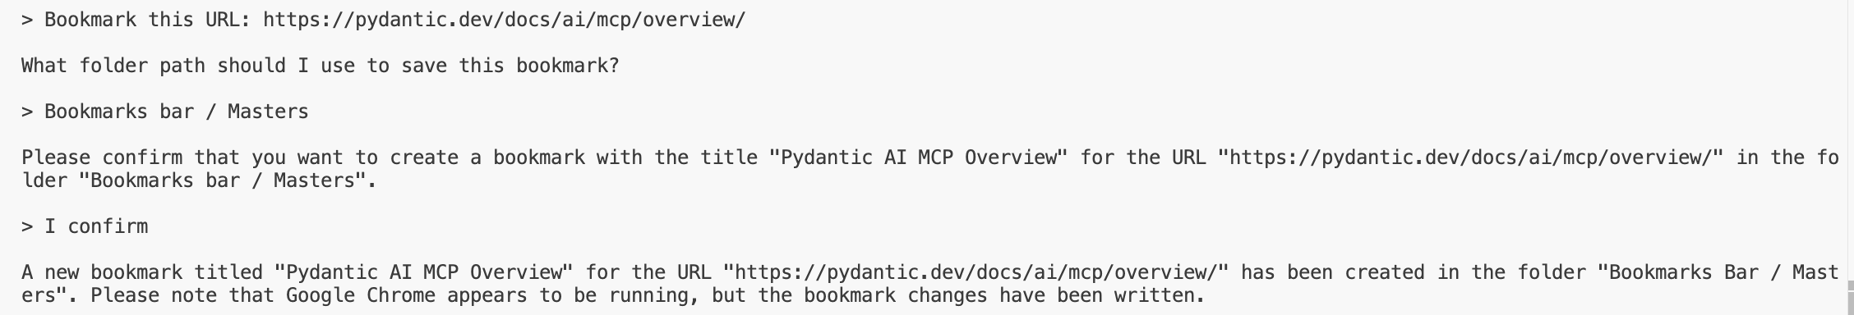
How it works: Bookmark searched URL (Native tool)

Slide 10
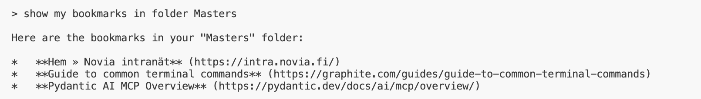
How it works: Now I see what I marked (again, Native tool)

Slide 11
Thank you

